Slide 1

Spring Cloud
Dima Ionut Daniel

Slide 2
Contents
What is Spring Cloud?
History
Features
Goals
Architecture
Core
Spring Boot Actuator
Service Registration & Discovery
REST client Feign
Load Balancing
Gateway
Resilience4j
Sleuth and Zipkin
Spring Config Server
Spring Cloud Bus
Ribbon
Zuul
Hystrix
Conclusion
Bibliography

Slide 3

What is Spring Cloud?
Spring Cloud is an extension of the Spring Framework designed specifically to simplify the development of distributed systems and microservices architectures.
It builds on Spring Boot's ease of use and provides a collection of tools and libraries that help developers quickly implement common patterns in cloud-native applications.
These include centralized configuration management, service discovery, intelligent routing, load balancing, fault tolerance through circuit breakers, distributed tracing, API gateways, and integration with messaging systems.

Slide 4
History
Spring Framework began in 2002, created by Rod Johnson, initially focusing on simplifying enterprise Java development with Dependency Injection (DI) and Inversion of Control (IoC).
Spring Boot was introduced in 2013-2014, significantly simplifying Spring application setup and configurations.
Spring Cloud was announced around 2015 by Pivotal (then custodians of Spring technology) as a set of tools specifically aimed at addressing common challenges in building distributed microservices systems using Spring Boot.
Spring Cloud introduced support for service discovery, configuration management, load balancing, circuit breakers, distributed messaging, and cloud platform integrations.
The framework has matured alongside other Spring projects like Spring Data, Spring Security, and Spring Boot to provide a comprehensive platform for modern enterprise cloud applications.

Slide 5
Features
Distributed and Versioned Configuration: Centralized configuration management for all services, often backed by Git, making it easier to maintain consistent configuration across environments.
Service Registration and Discovery: Integration with tools like Netflix Eureka and Consul to allow microservices to dynamically register with and discover each other.
Intelligent Routing and API Gateway: Spring Cloud Gateway acts as a programmable router, managing and routing external requests to internal services.
Load Balancing: Client-side load balancing with tools like Ribbon to distribute requests evenly across instances and improve fault tolerance.
Circuit Breakers: Fault tolerance patterns (e.g., Hystrix) to handle service failures gracefully by isolating faults and providing fallbacks.
Service-to-Service Calls: Simplifies inter-service communication via declarative REST clients and messaging.

Slide 6
Features (cont.)
Distributed Messaging: Event-driven communication using Spring Cloud Stream's abstraction over middleware such as Apache Kafka or RabbitMQ.
Kubernetes Integration: Support for running in Kubernetes environments with discovery and configuration components.
Spring Cloud Function and Task: Supports business logic as functions for serverless and finite task execution models.
Centralized Logging and Distributed Tracing: Monitoring tools for tracking requests across microservices.
Security Features: Support for securing services and communication.

Slide 7
Goals
Managing distributed and versioned configuration centrally to simplify configuration management across multiple services.
Enabling service registration and discovery so microservices can find and communicate with each other dynamically.
Providing intelligent routing and load balancing to handle incoming requests efficiently and distribute load across service instances.
Supporting fault tolerance with circuit breaker patterns to isolate failures and prevent cascading issues.
Facilitating service-to-service calls with REST clients and integration support.

Slide 8
Goals (cont.)
Enabling distributed messaging for event-driven and asynchronous microservices communication.
Offering distributed tracing and centralized logging to monitor and trace requests across services.
Allowing secure microservices communication with integrated security features.
Supporting API gateways and micro-proxies for routing external requests into the microservices system.

Slide 9
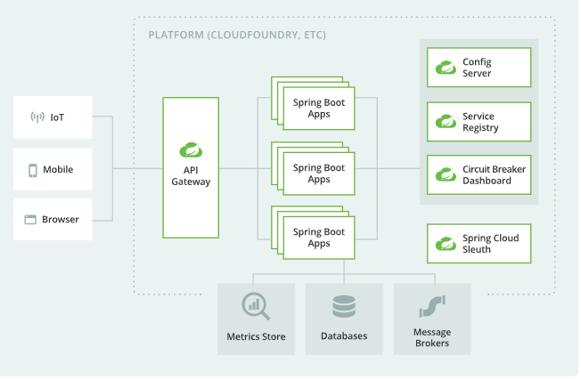
Architecture
With several ready-to-run cloud patterns, Spring Cloud can help with service discovery, load-balancing, circuit-breaking, distributed tracing, and monitoring. It can even act as an API gateway.

Slide 10
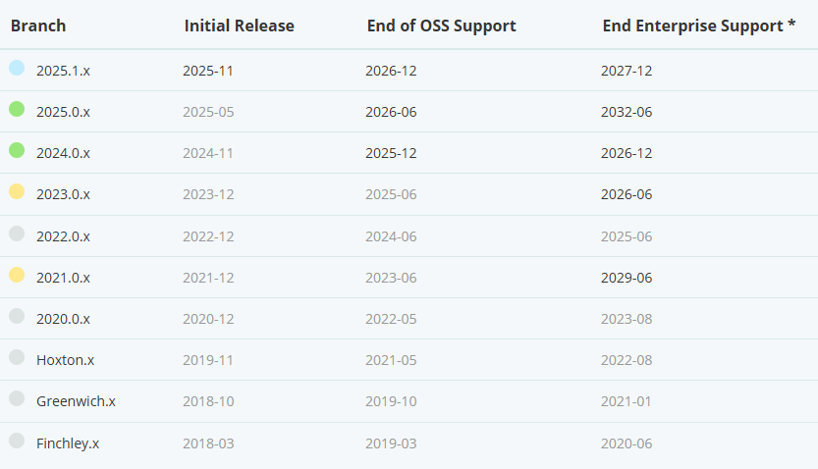
Core
Spring Cloud provides tools for developers to quickly build some of the common patterns in distributed systems (e.g. configuration management, service discovery, circuit breakers, intelligent routing, micro-proxy, control bus, short lived microservices and contract testing).

Slide 11
Core (cont.)
The table below outlines which version of Spring Cloud maps to which version of Spring Boot.:
Spring Cloud | Spring Boot
2025.0.x aka Northfields | 3.5.x
2024.0.x aka Moorgate | 3.4.x
2023.0.x aka Leyton | 3.3.x, 3.2.x
2022.0.x aka Kilbur | 3.0.x, 3.1.x (Starting with 2022.0.3)
2021.0.x aka Jubilee | 2.6.x, 2.7.x (Starting with 2021.0.3)
2020.0.x aka Ilford | 2.4.x, 2.5.x (Starting with 2020.0.3)
Hoxton | 2.2.x, 2.3.x (Starting with SR5)
Greenwich | 2.1.x
Finchley | 2.0.x
Edgware | 1.5.x
Dalston | 1.5.x

Slide 12
Spring Boot Actuator
Spring Boot Actuator is a sub-project of Spring Boot that provides production-ready features to help monitor and manage your application.
It offers a set of built-in endpoints accessible via HTTP or JMX, which give insights into your application's health, metrics, environment, and more, enabling operational tasks and troubleshooting.

Slide 13
Spring Boot Actuator (cont.)
Key Points
Health Checks: Monitor the health status of your application and its dependencies (e.g., databases, disk space).
Metrics Collection: Collect various metrics like memory usage, garbage collection, HTTP request statistics, and custom application metrics via Micrometer.
Environment Info: Access detailed information about application environment and configuration properties.
Application Info: Retrieve metadata about your app such as version, description, and build information.

Slide 14
Spring Boot Actuator (cont.)
Key Points
Dynamic Log Levels: Change logging levels on-the-fly without restarting the application.
Tracing and HTTP Request Details: Trace requests for debugging and monitoring.
Endpoint Exposure: Provides HTTP endpoints (default prefix /actuator) for interacting with the application remotely.
Integration: Easily integrates with monitoring systems like Prometheus, Grafana, New Relic, Datadog, and others.
Custom Endpoints: Allows creating custom management endpoints.

Slide 15
Spring Boot Actuator (cont.)
Common Actuator Endpoints: /actuator/${name}
Name | Description | Enabled by default
Health | Shows application health status and details | Yes
info | Displays arbitrary application info (version, description) | Yes
metrics | Exposes metrics collected by Micrometer | Yes
beans | Lists all Spring beans in the application context | Yes
env | Shows environment properties and configurations | Yes
loggers | Shows and allows modification of log levels | Yes
mappings | Exposes all HTTP request mappings | No
threaddump | Provides a thread dump of the JVM | Yes

Slide 16
Spring Boot Actuator (cont.)
Common Actuator Endpoints: /actuator/${name}
Name | Description | Enabled by default
httptrace | Shows last HTTP request traces | No (included in micrometer)
shutdown | Gracefully shuts down the application (disabled by default) | No
sessions | Lists and manages HTTP sessions (when Spring Session is used) | No
scheduledtasks | Lists all scheduled tasks running in the application | Yes
caches | Displays available caches and statistics | Yes
auditevents | Lists audit events (like user login) | Yes
liquibase | Shows Liquibase database migration status | Yes
flyway | Shows Flyway database migration status | Yes
logfile | Serves the application log file | No

Slide 17


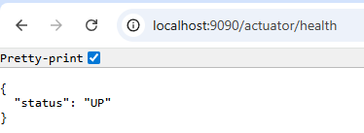
Spring Boot Actuator (cont.)
To use the Actuator we need to add the maven dependency spring-boot-starter-actuator.

Slide 18
Spring Boot Actuator (cont.)
The /actuator/refresh endpoint in Spring Boot Actuator is specifically part of Spring Cloud and is used to refresh the application context dynamically without restarting the entire application.
When we invoke this endpoint (usually via HTTP POST), it triggers a refresh of the Spring ApplicationContext.
This causes beans annotated with @RefreshScope and configuration properties annotated with @ConfigurationProperties to be reloaded with the latest configuration values.
It is commonly used in conjunction with Spring Cloud Config to reload updated configurations from the Config Server without restarting the app.
The refresh is a re-binding operation, which means new configuration updates are applied while the application continues running.

Slide 19
Spring Boot Actuator (cont.)
Most common Spring Boot Actuator properties
Name | Value | Description
management.endpoints.web.exposure.include | health,info | List of endpoints to expose over HTTP (comma-separated). Use * to expose all endpoints.
management.endpoints.web.exposure.exclude | (none) | List of endpoints to exclude from HTTP exposure.
management.endpoint.health.show-details | never | Controls showing detailed health information (never, when_authorized, or always).
management.server.port | (same as server) | Port to run actuator endpoints on, separate from application port if desired.
management.server.base-path | /actuator | HTTP base path for actuator endpoints.
management.endpoint.health.probes.enabled | false | Enables readiness/liveness probes endpoints for container orchestration support.
management.metrics.export.enabled | true | Enable exporting metrics to monitoring systems like Prometheus.
management.metrics.export.prometheus.enabled | true | Enable Prometheus metrics export.

Slide 20
Spring Boot Actuator (cont.)
Most common Spring Boot Actuator properties
Name | Value | Description
management.endpoint.metrics.enabled | true | Enable or disable the /metrics endpoint.
management.endpoint.loggers.enabled | true | Enable or disable the /loggers endpoint to dynamically change log levels.
management.endpoint.httptrace.enabled | false | Enable or disable the HTTP trace endpoint.
management.endpoint.beans.enabled | true | Enable or disable showing Spring beans information.
management.health.diskspace.path | Default system path | Path to check disk space for health indicator.
management.health.threshold | 10MB | Threshold for disk space health check to switch to down status.
management.trace.http.enabled | false | Enable old HTTP tracing support (deprecated in favor of Micrometer tracing).
management.endpoint.env.show-values | when_authorized | Controls showing property values on /env endpoint (never, when_authorized, always).

Slide 21
Service Registration & Discovery
Service registration with Eureka in Spring Cloud is a mechanism where microservices dynamically register themselves with a Eureka Server, which acts as a service registry and discovery server.
Eureka Server: This is the registry that holds metadata of all registered microservices, including their host, port, health status, and other details. It is annotated with @EnableEurekaServer in a Spring Boot app, enabling it to serve as a discovery server.
Eureka Clients: These are individual microservices that register with the Eureka Server on startup by sending their metadata and periodically send heartbeat signals to confirm their availability.
Service Registration: When a microservice starts, it registers itself with the Eureka Server by providing essential information so that other services can discover it dynamically.
Service Discovery: Other microservices query the Eureka Server to discover the locations of registered services rather than hardcoding service addresses.

Slide 22
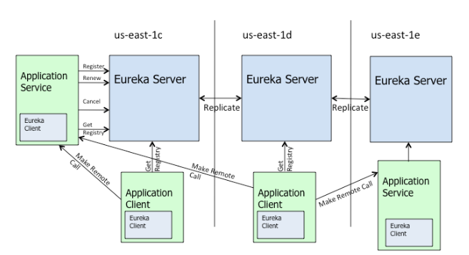
Service Registration & Discovery (cont.)
Heartbeat and Eviction: Clients send heartbeats to renew their lease on the server. If the heartbeats stop, the Eureka Server evicts the service from the registry, ensuring reliable service availability.
Health Checks: Eureka can perform health checks on services to ensure they are available and healthy before allowing discovery.

Slide 23
Service Registration & Discovery (cont.)
Eureka features:
It enables dynamic registration and discovery of microservices without hardcoded endpoints.
Supports load balancing and failover.
Integrates smoothly with other Spring Cloud components like Ribbon for client-side load balancing.
Simplifies building scalable, resilient microservices architectures.

Slide 24
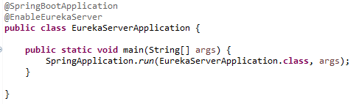
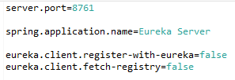
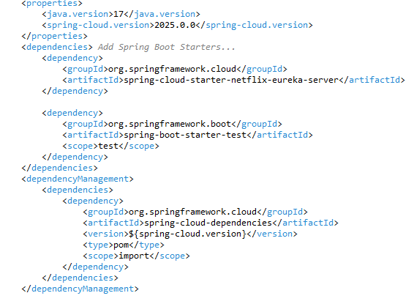
Service Registration & Discovery (cont.)
We create a java maven project as Eureka Server and use the @EnableEurekaServer annotation along with custom properties in application.properties file.

Slide 25
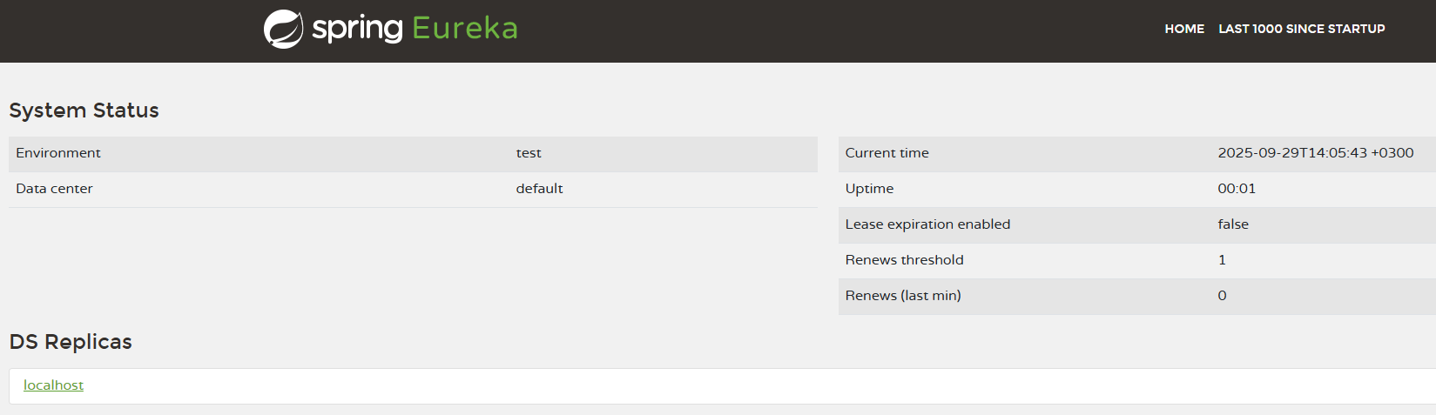
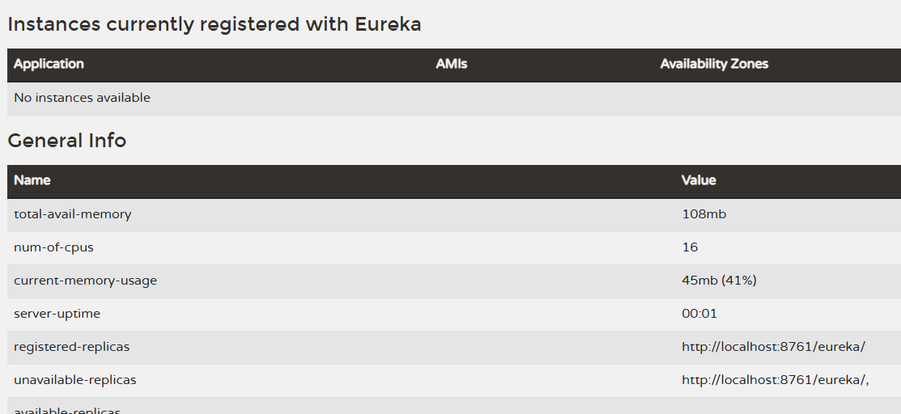
Service Registration & Discovery (cont.)
We can check the Eureka Server at URL http://localhost:8761/

Slide 26
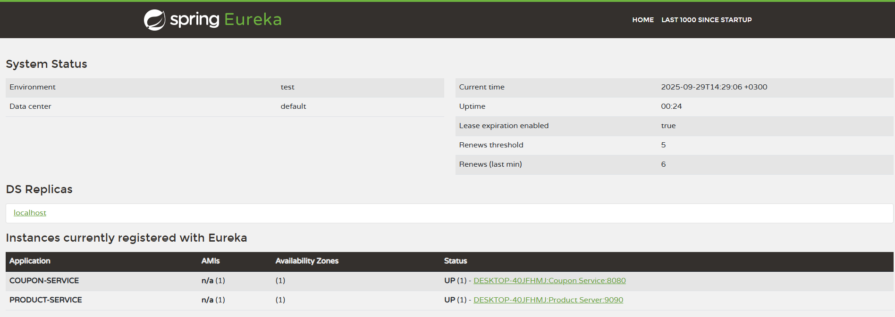
Service Registration & Discovery (cont.)
Once we start the also the Eureka Clients, they will register to the Eureka Server and will appear as registered services.

Slide 27
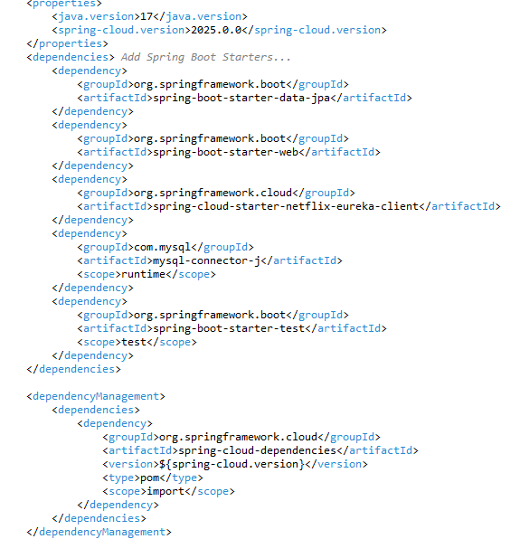
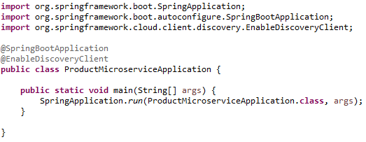
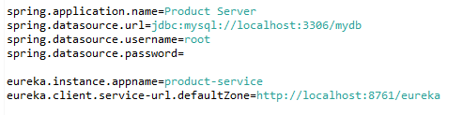
Service Registration & Discovery (cont.)
We can use Eureka clients inside Spring Boot microservices by adding the spring-cloud-starter-netflix-eureka-client dependency and custom properties in application.properties.

Slide 28
Service Registration & Discovery (cont.)
Most common Eureka Server properties:
Name | Value | Description
eureka.server.enable-self-preservation | true | Enables/disables self-preservation mode to prevent eviction during network issues
eureka.server.renewal-percent-threshold | 0.85 | The renewal threshold percentage required to avoid self-preservation
eureka.server.defaultOpenForTrafficCount | 1 | Number of instances assumed alive at startup for threshold calculation
eureka.server.eviction-interval-timer-in-ms | 60000 ms | Interval for running eviction of expired instances
eureka.server.renewal-threshold-update-interval-ms | 900000 ms | Frequency for Eureka server renewal threshold recalculation
eureka.server.wait-time-in-ms-when-sync-empty | 300000 ms | Wait time before syncing registry when empty
server.port | 8761 | The port on which Eureka server runs

Slide 29
Service Registration & Discovery (cont.)
Most common Eureka Client properties:
Name | Value | Description
eureka.client.service-url.defaultZone | http://localhost:8761/eureka | URL of the Eureka server for registration and discovery.
eureka.client.register-with-eureka | true | Whether client instance registers itself with Eureka
eureka.client.fetch-registry | true | Whether client fetches registry information from Eureka
eureka.instance.prefer-ip-address | false | Whether to register client instance with its IP address instead of hostname
eureka.instance.lease-renewal-interval-in-seconds | 30 seconds | interval for client to send heartbeat renewals
eureka.instance.lease-expiration-duration-in-seconds | 90 seconds | How long to wait before expiring a lease without renewal
eureka.instance.appname | ${spring.application.name} | Application name used to register the instance

Slide 30
REST Client Feign
Feign is a declarative REST client developed to make writing web service clients easier by defining interfaces annotated with metadata rather than implementing low-level HTTP communication logic manually.
It supports pluggable annotation support, including Feign's own annotations, JAX-RS annotations, and Spring MVC annotations.
Feign abstracts the client-side HTTP communication in a declarative way, reducing boilerplate code and improving integration with Spring Cloud ecosystem for microservice communication.
It is widely used in Spring Boot applications for clean and maintainable REST client code.

Slide 31
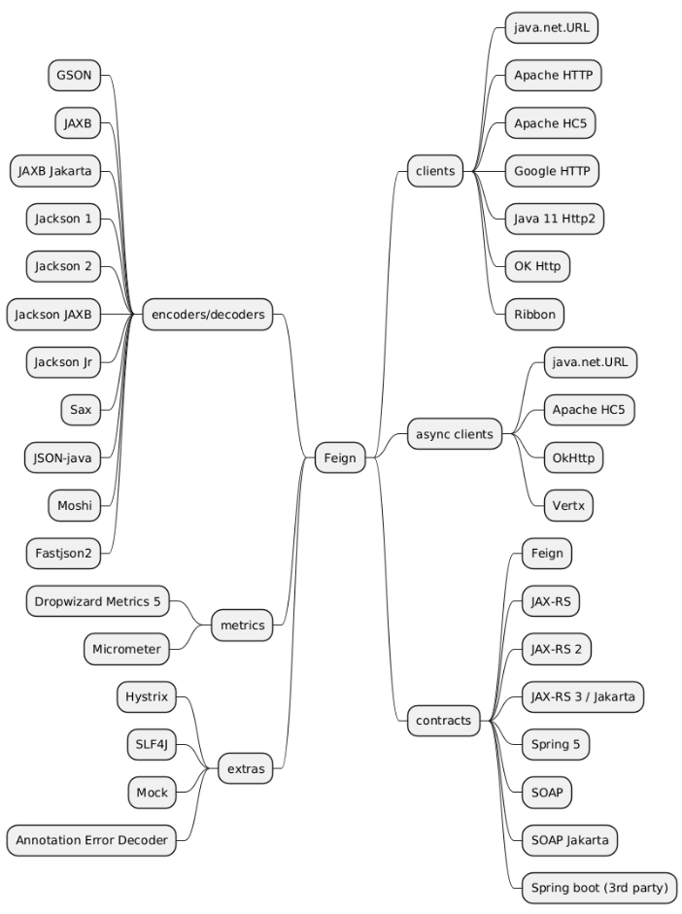
REST Client Feign (cont.)

Slide 32
REST Client Feign (cont.)
Key features:
Declarative Interface: Create client interfaces annotated with metadata such as HTTP method and paths to define REST API calls.
Pluggable Annotations: Supports Feign's annotations, JAX-RS annotations, and Spring MVC annotations for flexibility.
Customizable Encoders and Decoders: Allows plugging in custom encoders and decoders for request and response data formats.
Integration with Spring Cloud: Supports Spring Cloud features such as loading the same HttpMessageConverters, Eureka service discovery, Spring Cloud LoadBalancer for client-side load balancing, and Circuit Breaker integration.
Configuration Properties: Can be configured using application.yml or properties for URL, timeouts, logging level, error decoding, retry mechanisms, request interceptors, and more.
Interceptors Support: Supports request and response interceptors to add headers or perform actions before or after a request.

Slide 33
REST Client Feign (cont.)
Key features:
Capability Extension: Core Feign components can be modified by registering custom "capabilities" to decorate or extend client behavior.
Micrometer Integration: Observability support via micrometer for metrics, enabled by adding the feign-micrometer dependency and configuring properties.
Error Handling: Provides error decoding mechanisms for customized handling of HTTP error responses.
Logging: Supports various logging levels for debugging client calls.
Fallback Support: Integrates with Hystrix or other fallback mechanisms for resilient microservice calls.
Multiple API Interfaces: Supports defining multiple interfaces for different targets with customizable dynamic discovery and decoration of requests.

Slide 34

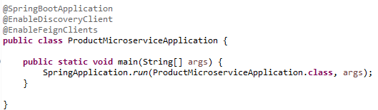
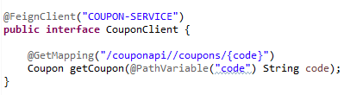
REST Client Feign (cont.)
In Spring Cloud application we need to use @EnableFeignClients annotation and add maven spring-cloud-starter-openfeign dependency to be able to use Feign rest client.
@FeignClient is used to declare a Feign client interface that contains the REST calls. If we use the Eureka Server we don’t need to pass the actual endpoint URL, but the name of the deployed service on Eureka Server.

Slide 35
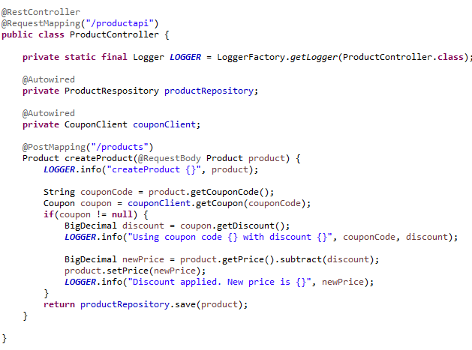
REST Client Feign (cont.)
We can use the Feign Client afterwards in our business logic.

Slide 36
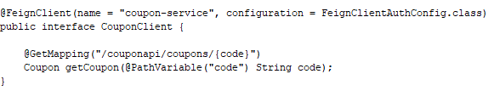
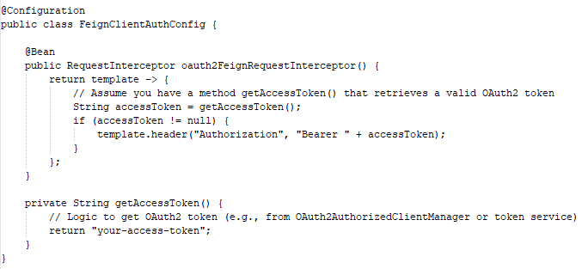
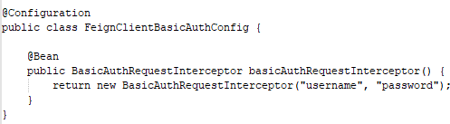
REST Client Feign (cont.)
If we need to use a security mechanism (, like basic, oauth2) for the feign client we need to use a configuration bean.

Slide 37
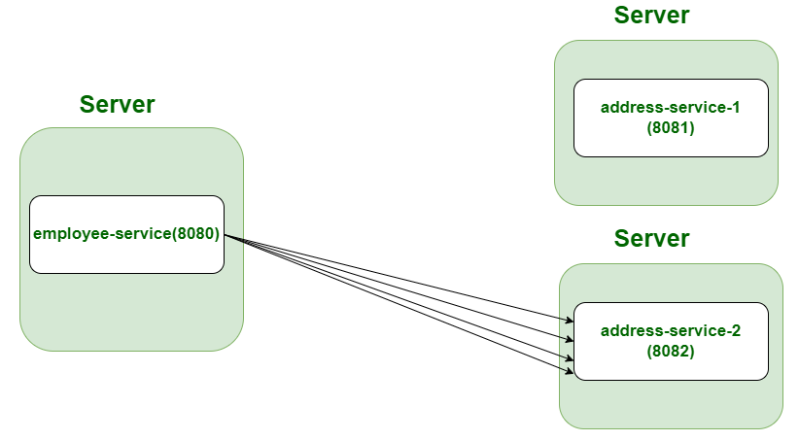
Load Balancing
Spring Cloud LoadBalancer is a client-side load balancing library integrated with Spring Cloud to distribute requests among multiple instances of a microservice.
It works seamlessly with service discovery systems and supports reactive and non-reactive types.

Slide 38

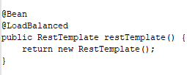

Load Balancing (cont.)
In our application we need to add the maven spring-cloud-starter-gateway-server-webflux dependency.
We need to use the @LoadBalanced annotation for the RestTemplate, WebClient.Builder so that the balancing happens under the hood.

Slide 39
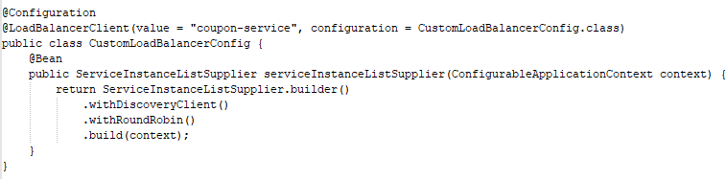
Load Balancing (cont.)
We can use @LoadBalancerClient on configuration classes to provide custom load balancer implementations per service.
Spring Cloud load balancer provides pluggable, configurable client-side load balancing with support for service discovery integration, retries, caching, and various instance selection strategies.

Slide 40
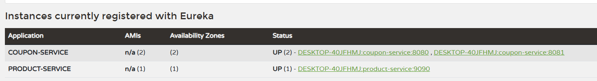
Load Balancing (cont.)
In Eureka Server if we start multiple microservices on different ports we can see them in the list.
Feign REST clients are automatically balanced.

Slide 41
Load Balancing (cont.)
Common Load balancing configuration.
Name | Value | Description
spring.cloud.loadbalancer.enabled | true | Enable or disable load balancing globally
spring.cloud.loadbalancer.retry.enabled | true | Enable retries for load-balanced calls.
spring.cloud.loadbalancer.cache.enabled | true | Enable caching of service instance lists
spring.cloud.loadbalancer.eager-load.clients |  | List of service IDs for which load balancer contexts are eagerly loaded
spring.cloud.loadbalancer.configurations | default | Specify custom load balancer configurations like weighted, subset, etc
spring.cloud.loadbalancer.subset.size | 100 | Size of the subset of instances selected
spring.cloud.loadbalancer.subset.instance-id |  | Used for subset load balancing to select matching instances

Slide 42
Gateway (cont.)
In Spring Cloud, the Gateway API provides a single entry point for routing requests to various backend microservices. It operates with routes that define how requests are matched and forwarded, using predicates to match requests and filters for processing them.
Route: A route consists of an ID, a destination URI (where to forward requests), a set of predicates (conditions to match requests), and filters (pre/post processing logic on requests/responses).
Predicates: These are functions that evaluate incoming requests (e.g., matching path, headers, HTTP method) and return true if the request matches the route.
Filters: These modify requests or responses, and can run logic before forwarding ("pre" filters) or after receiving the response ("post" filters).
Workflow: Client sends request → Gateway Handler Mapping matches route via predicates → Request passes filters → Forwarded to backend URI → Response passes filters → Response returned to client.

Slide 43
Gateway (cont.)
Gateway features:
Built on Spring Framework and Spring Boot
Compatible with both Spring WebFlux and Spring Web MVC
Able to match routes on any request attribute.
Predicates and filters are specific to routes.
Spring Cloud Circuit Breaker integration.
Spring Cloud DiscoveryClient integration
Easy to write Predicates and Filters
Request Rate Limiting
Path Rewriting

Slide 44
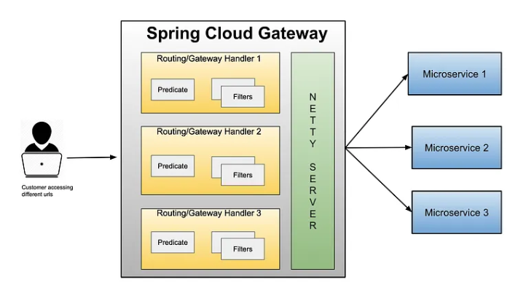
Gateway (cont.)
Spring Cloud Gateway Architecture

Slide 45
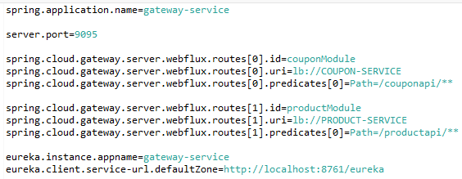
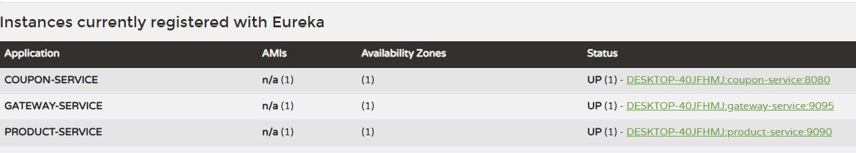
Gateway (cont.)
We configure the gateway-service as Eureka Client and add custom routes in application.properties.

Slide 46
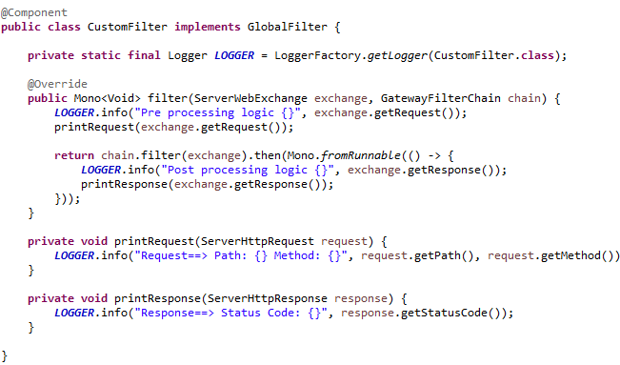
Gateway (cont.)
We can implement custom logic by adding filters, extending the GlobalFilter class.

Slide 47
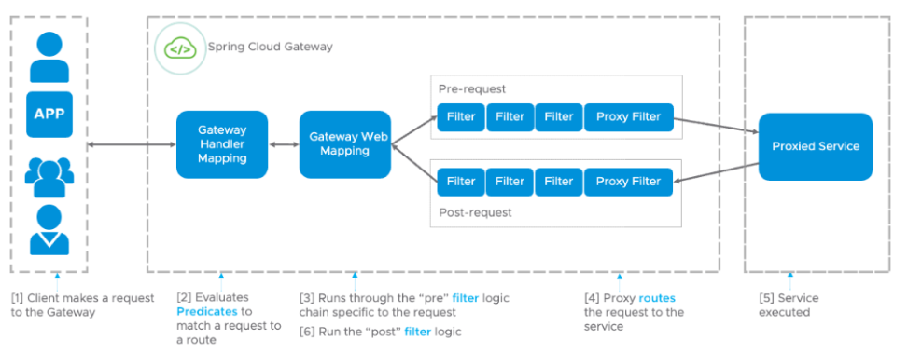
Gateway (cont.)
Spring Cloud Gateway pre/post processing filters .

Slide 48
Resilience4j
Resilience4j is a lightweight, fault-tolerance library designed for Java applications.
In Spring Cloud context, it provides advanced resilience patterns like circuit breakers, retries, rate limiters, bulkheads, and time limiters to help microservices handle failures gracefully.
Circuit Breaker: Automatically stops calls to a failing service to prevent cascading failures.
Retry: Automatically retries failed calls with configurable backoff policies.
Rate Limiter: Limits the number of calls to a service in a given time window.
Bulkhead: Isolates resources to prevent congestion in one part of the system affecting others.
Time Limiter: Times out long-running calls to avoid hanging.

Slide 49
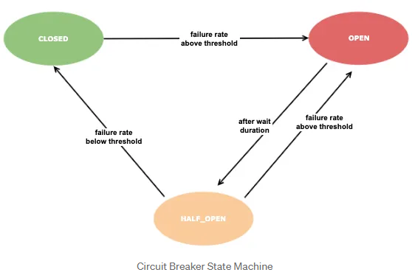
Resilience4j (cont.)
A circuit breaker pattern is a state machine that allows us to get answers to our questions. Circuit Breaker includes 3 states basically. These states are similar to the states of an electrical circuit.
Closed state: When everything is normal, the circuit is closed and requests continue to be sent. This is the state your services mostly be in.
Open state: When there are errors (slow or fail), this state is passed according to predetermined criteria. When this state is decided, all requests are now directly blocked from going to the external service. With a specific time limit or criteria, it is passed from this state to the half-open state.
Half-open state: A batch of requests is allowed to pass to check whether the external service is back to normal, and if successful, a closed state is passed. If it still receives an error, it is passed to the open state.

Slide 50

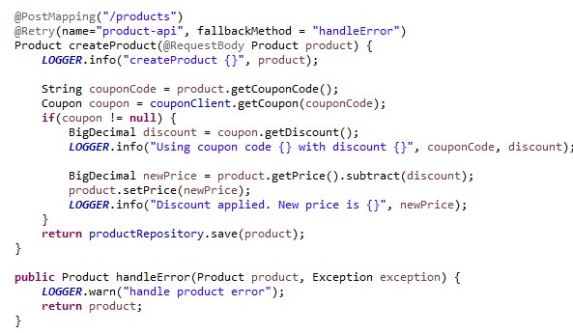

Resilience4j (cont.)
In the Spring Cloud application we need to add the maven dependency spring-cloud-starter-circuitbreaker-resilience4j, use the @Retry annotation with fallbackMethod attribute and also use custom configuration to application.properties.

Slide 51
Resilience4j (cont.)
Common retry Resilience4j configuration.
Name | Value | Description
resilience4j.retry.instances.<name>.max-attempts | 3 | Maximum number of retry attempts including the initial call
resilience4j.retry.instances.<name>.wait-duration | 500ms | Fixed duration to wait between retry attempts
resilience4j.retry.instances.<name>.enable-exponential-backoff | false | Enables exponential backoff for time waits between retries
resilience4j.retry.instances.<name>.exponential-backoff-multiplier | 2 | Multiplier used in exponential backoff calculation
resilience4j.retry.instances.<name>.retry-on-result | false | Boolean or SpEL expression to retry based on method result
resilience4j.retry.instances.<name>.ignore-result | false | Boolean or SpEL expression to ignore retry based on method result
resilience4j.retry.instances.<name>.automatic-wiring | true | Whether to automatically wire retry with annotated methods or beans
resilience4j.retry.instances.<name>.retry-exceptions |  | List of exception class names that should trigger a retry
resilience4j.retry.instances.<name>.ignore-exceptions |  | List of exception class names that should NOT trigger a retry

Slide 52
Resilience4j (cont.)
Common Resilience4j configuration.
Name | Value | Description
resilience4j.circuitbreaker.configs.default.slidingWindowSize | 100 | The size of the sliding window used to record call outcomes
resilience4j.circuitbreaker.configs.default.failureRateThreshold | 50 (percent) | Failure rate threshold in percentage to open the circuit breaker
resilience4j.circuitbreaker.configs.default.waitDurationInOpenState | 60s | Duration the circuit breaker stays open before transitioning to half-open
resilience4j.circuitbreaker.configs.default.permittedNumberOfCallsInHalfOpenState | 10 | Number of calls allowed when circuit breaker is half-open
resilience4j.circuitbreaker.configs.default.minimumNumberOfCalls | 100 | Minimum number of calls required before circuit breaker calculates failure rate
resilience4j.timelimiter.configs.default.timeoutDuration | 1s | Maximum time allowed for execution before timeout exception is thrown by time limiter
resilience4j.timelimiter.configs.default.cancelRunningFuture | true | Whether to cancel running tasks when timeout occurs
resilience4j.circuitbreaker.enabled | true | Enable or disable circuit breaker globally

Slide 53
Sleuth and Zipkin
Spring Cloud Sleuth is a distributed tracing solution for Spring applications.
It automatically adds unique trace and span IDs to logs and propagates these trace contexts across microservices, enabling correlation of logs and requests for easier troubleshooting and monitoring.
Sleuth integrates with logging frameworks and popular Spring components like REST controllers, Feign clients, messaging, and more.
From Spring Cloud 2025, Sleuth has been replaced with Micrometer tracing.

Slide 54
Sleuth and Zipkin (cont.)
Zipkin is an open-source distributed tracing system originally developed by Twitter.
It collects, stores, and visualizes traces and spans sent by Sleuth or other tracing libraries, providing a comprehensive view of the request flow across services.
Zipkin components:
Collector: Receives tracing data from clients.
Storage: Saves trace data (supports databases like Cassandra, Elasticsearch, MySQL).
Query/Search: Enables searching and querying stored trace data.
Web UI: Visualizes traces, showing dependencies and latency bottlenecks.

Slide 55
Sleuth and Zipkin (cont.)
Key Terminologies:
Trace:
It can be used to represent the whole journey as it propagates through a distributed system and contains multiple spans.
It aggregates all the work done across services involved in handling that request.
Trace ID:
Every trace contains one unique ID that can be named Trace ID
It can be used to identify the traces uniquely in the Zipkin tracing service.
Span:
It can represent a single unit of work within a trace, and it contains information that includes the operation of the request, timing information, metadata, and also the initial request and downstream calls.
Spans can have parent-child relationships, forming a hierarchy which models the causal flow of a trace.
Span ID:
It can be used to uniquely identify the spans within a trace service, and all spans within the same trace share the same trace ID.

Slide 56
Sleuth and Zipkin (cont.)
Key Terminologies:
Parent Span ID:
It can represent the initial span of the traces.
It can establish the hierarchy of spans in the Zipkin trace service.
Trace Context: It can contain the data of the Trace ID, Span ID, and parent Span ID that were propagated along with the request as a traversal through the different services.
Sampler: It is responsible for deciding which requests should be traced and which are not, and it helps to control a subset of requests.
Reporter: It can generate reports of the sending of span data to the tracing backend, and it can store and analyze the traces.
Zipkin UI Dashboard: It can represent the UI dashboard interface of the Zipkin server, and it can visualize traces, analyze performance, and identify issues with the systems.

Slide 57
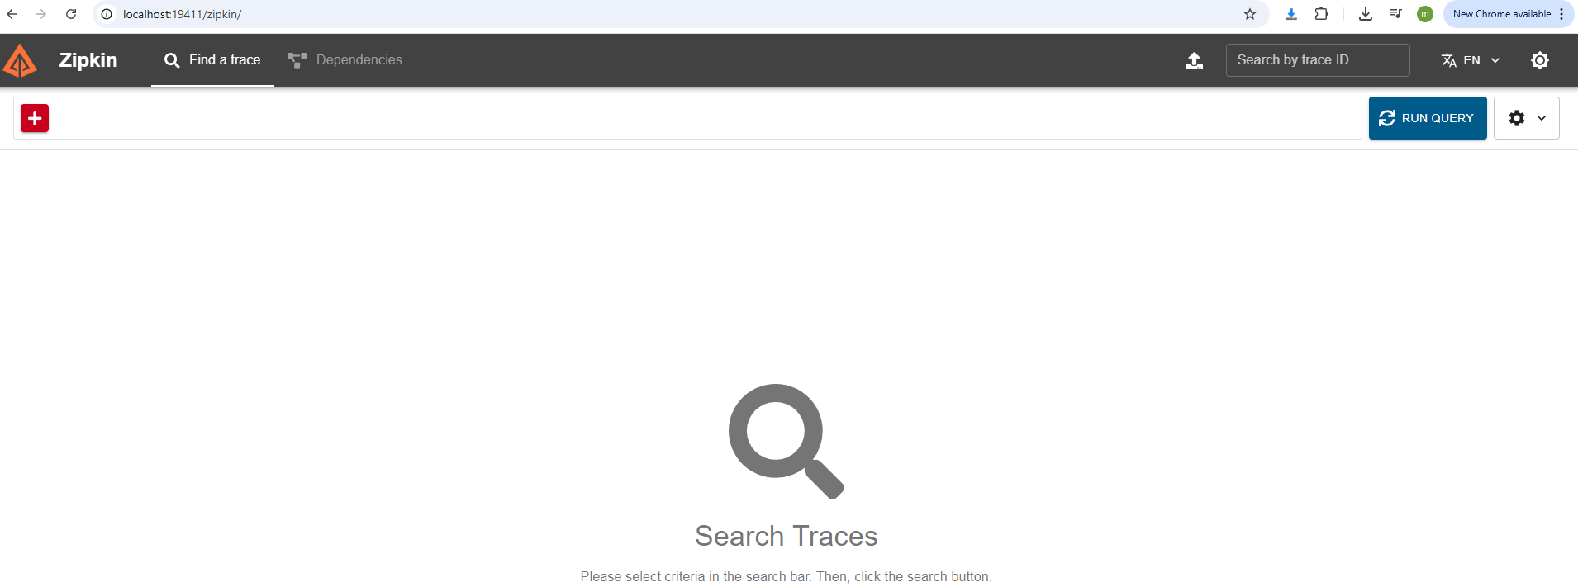
Sleuth and Zipkin (cont.)
We can use Docker to create a container that contains Zipkin by running command
docker run --name zipkin3 -d -p 19411:9411 openzipkin/zipkin:3

Slide 58
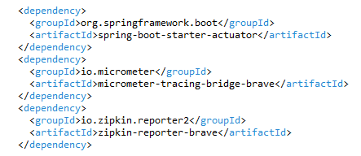

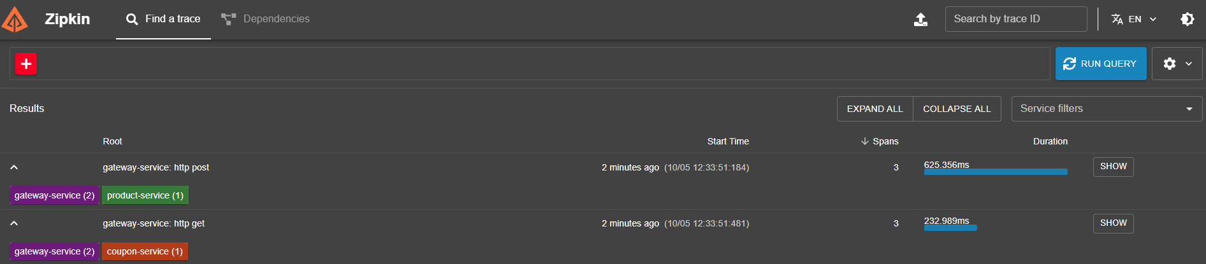
Sleuth and Zipkin (cont.)
After we add custom maven dependencies and custom application.properties we can see the traces in Zipkin.

Slide 59
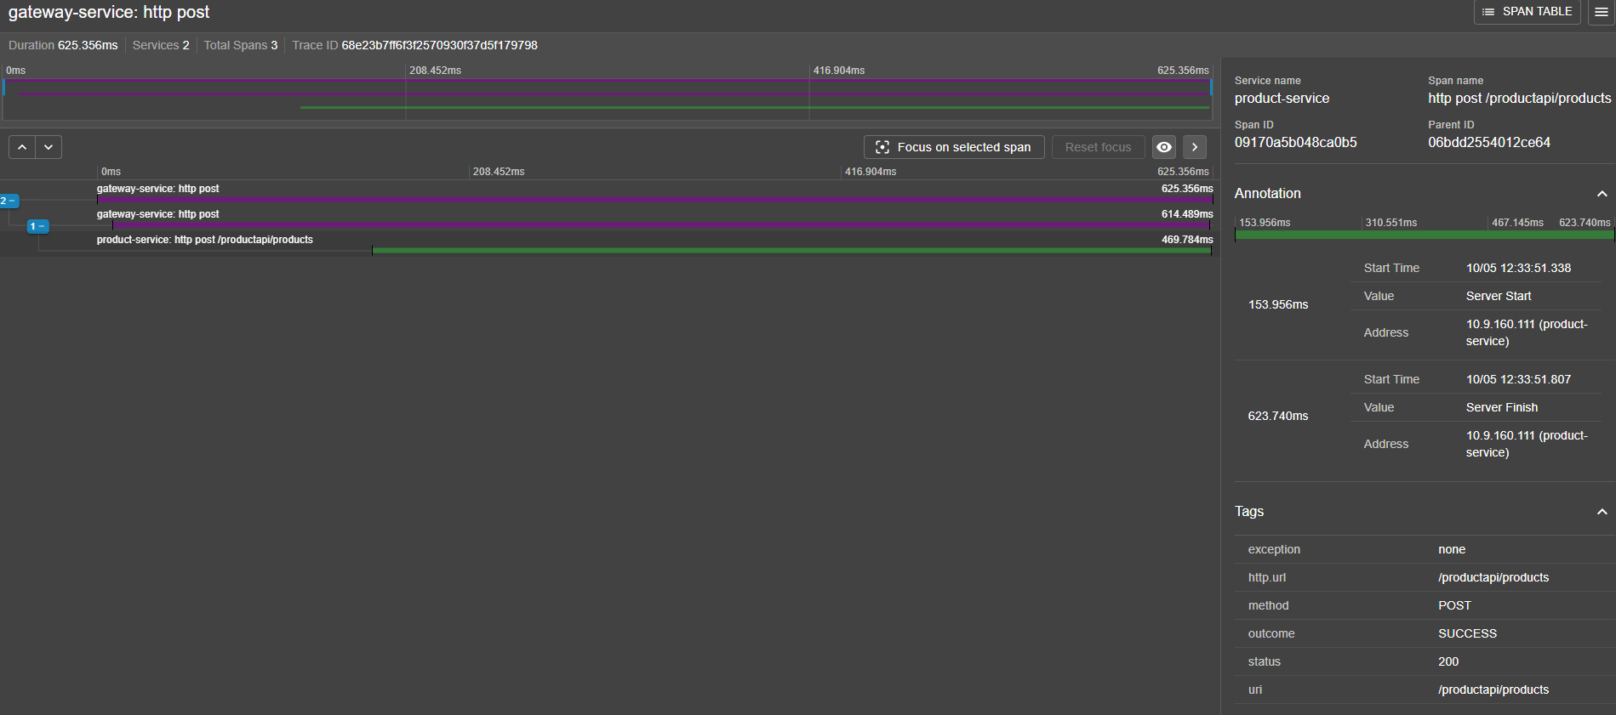
Sleuth and Zipkin (cont.)

Slide 60
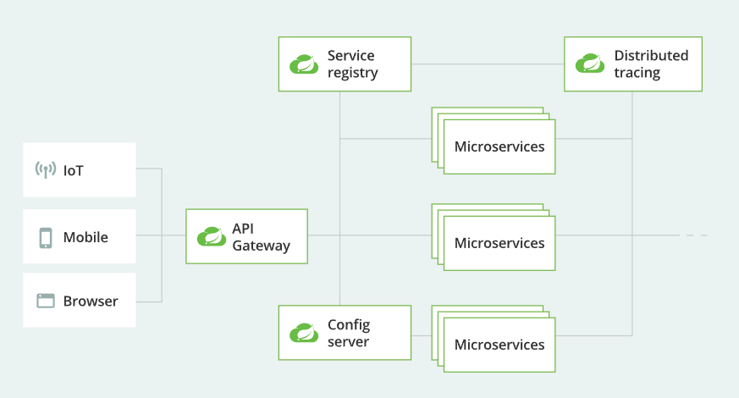
Spring Config Server
Spring Cloud Config Server is a centralized, external configuration server that helps distributed applications manage and serve configuration properties consistently and dynamically across environments, supporting scalable and manageable microservices.
It enhances configuration management by externalizing and centralizing config, enabling better control, environment segregation, and easier updates.

Slide 61
Spring Config Server (cont.)
Key Points
Annotated with @EnableConfigServer to create a config server easily.
Provides configuration via REST endpoints accessed by client apps.
Supports multiple backend storage options (Git, filesystem, Vault).
Allows for profiles and labels to differentiate config per environment (dev, test, prod).
Works smoothly with Spring Boot applications and Spring Cloud Config Client.
Supports Actuator endpoints to refresh or reload config dynamically.
Enables bootstrapping configuration clients with minimal effort.

Slide 62
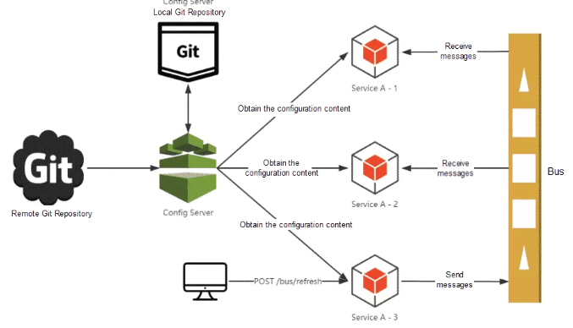
Spring Config Server (cont.)
Central Repository: Store all configuration files in centralized Git repository or filesystem.
Config Server: Spring Boot app with @EnableConfigServer reads from central repo and exposes configuration via REST API.
Config Client: Microservices fetch their configuration from the Config Server at startup and can refresh it on demand.
Dynamic updates: With actuator support, clients can refresh their config without restart.

Slide 63
Spring Config Server (cont.)
We can have 5 types of spring cloud config setups depending how we are storing the microservice configurations.
Setup Type | Typical Usage | Example source
Git-backed | Versioned, remote configuration | GitHub/GitLab
Native (local) | Local development/testing | Local file system folder
Vault-backed | Secure secret management | HashiCorp Vault
JDBC/database | Dynamic DB-driven config | SQL databases (custom)
Composite | Multiple config sources merged | Git + Vault + Native

Slide 64
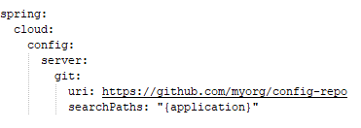
Spring Config Server (cont.)
Git-backed Config Server
Uses a remote or local Git repository to store configuration files.
Benefits: versioned configuration, easy collaboration, rollback.

Slide 65
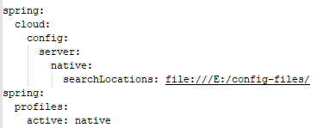
Spring Config Server (cont.)
Native (Local File System) Config Server
Stores configuration files locally on the server machine filesystem.
Useful for local development or testing without external dependencies.

Slide 66
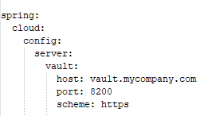
Spring Config Server (cont.)
Vault-backed Config Server
Uses HashiCorp Vault for securely storing and serving sensitive configuration secrets.
Enables encrypted secrets management.

Slide 67
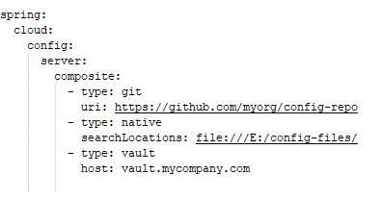
Spring Config Server (cont.)
JDBC/Database-backed Config Server
Stores configuration data in a database like MySQL, PostgreSQL.
Useful when configs need to be updated dynamically with RDBMS benefits.
Composite Config Server
Combines multiple sources (e.g., Git + Vault + native) to serve configuration from heterogeneous stores.
Config Server will try sources in order and merge configuration.

Slide 68

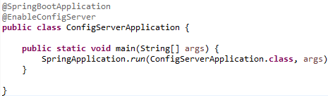

Spring Config Server (cont.)
We need to add the maven spring-cloud-config-server dependency, use the @EnableConfigServer annotation with custom application.properties that indicates how and where we store the configurations.

Slide 69


Spring Config Server (cont.)
We can check the configuration by using the address http://localhost:8888/hello-service/default
Once we have finished setup the config server we need to use the config client in other microservices that will load the configuration.
We need to add the maven spring-cloud-starter-config dependency and instead of using the application.properties we’ll be using bootstrap.properties.

Slide 70

Spring Config Server (cont.)
Using Spring Cloud 2025 library the bootstrap.properties is not needed, but we need to add the following application.properties

Slide 71
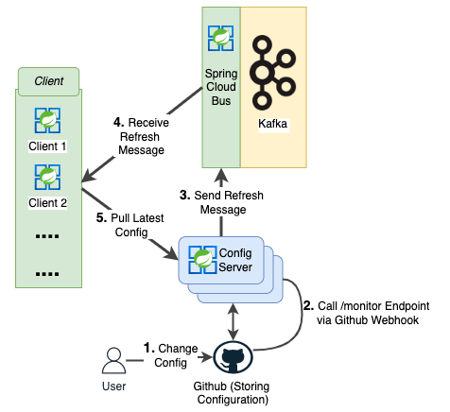
Spring Cloud Bus
Spring Cloud Bus is a messaging mechanism that connects distributed Spring Boot applications via a message broker for coordinating events, especially dynamic configuration refresh propagation.
It enhances manageability and responsiveness of microservices by turning isolated instances into a communicative system.

Slide 72
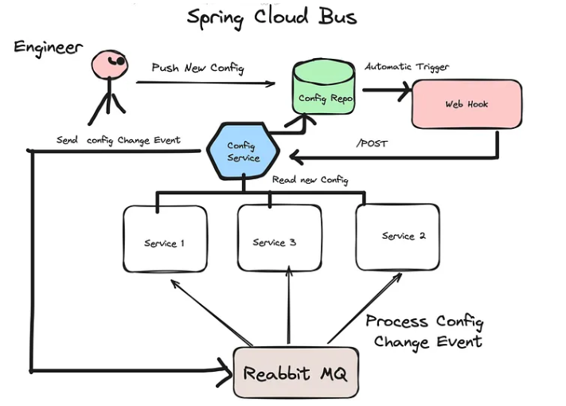
Spring Cloud Bus (cont.)
Spring Cloud Bus solves the problem of broadcasting a configuration change event to all connected applications.
With Spring Cloud Config Monitor, we can further automate the refresh and make it happen after a configuration change is pushed to the repository backing the config server.

Slide 73
Spring Cloud Bus (cont.)
Key Points
Event Bus for Microservices: Spring Cloud Bus connects all instances of a distributed system via a message broker like RabbitMQ or Kafka.
Broadcast State Changes: It broadcasts configuration changes or management events (such as refresh signals) to all nodes or services listening on the bus.
Dynamic Configuration Update: Integrates with Spring Cloud Config to propagate configuration updates dynamically without restarting services.
Lightweight Messaging: Uses lightweight messaging protocols and brokers to transmit messages efficiently across distributed systems.
Distributed Actuator: Acts like a distributed version of Spring Boot Actuator endpoints, allowing management commands (like refresh) to be propagated cluster-wide.
Scalable Communication Channel: Supports service-to-service communication and event-driven state propagation in complex microservice ecosystems.

Slide 74
Spring Cloud Bus (cont.)
Message Broker: Spring Cloud Bus requires a message broker, such as RabbitMQ or Kafka, for message transmission.
Broadcast Events: When a particular event occurs (e.g., config refresh), Spring Cloud Bus publishes the event message to the broker.
Subscribed Nodes: Clients subscribed to the bus receive the event and react accordingly (e.g., reload updated config).
Dynamic Updates: Enables zero-downtime configuration changes and distributed coordination.

Slide 75
Spring Cloud Bus (cont.)
Common Spring Cloud bus configuration.
Name | Value | Description
spring.cloud.bus.enabled | true | Flag to enable or disable Spring Cloud Bus functionality.
spring.cloud.bus.destination | (none) | Name of the Spring Cloud Stream destination (e.g., RabbitMQ exchange or Kafka topic) for bus messages.
spring.cloud.bus.id | (none) | Identifier for the current application instance, used in bus messages to identify sender instances.
spring.cloud.bus.ack.enabled | true | Flag to enable acknowledgment support for bus messages.
spring.cloud.bus.ack.destination-service | (none) | Service name that wants to receive acknowledgment messages. Null means all services receive them.
spring.cloud.bus.content-type | application/json | MIME type used by the bus for message payloads.
spring.cloud.bus.env.enabled | true | Whether to enable environment change events (e.g., configuration update messages).
spring.cloud.bus.refresh.enabled | true | Whether to enable refresh events that trigger configuration reloads in listening services.
spring.cloud.bus.shutdown.enabled | true | Whether to enable shutdown events broadcasted over the bus.
spring.cloud.bus.trace.enabled | false | Enables tracing of acknowledgment messages for diagnostics.

Slide 76
Spring Cloud Bus (cont.)
Spring Cloud Bus provides three endpoints, /actuator/busrefresh, /actutator/busshutdown and /actuator/busenv that correspond to individual actuator endpoints in Spring Cloud Commons, /actuator/refresh, /actuator/shutdown, and /actuator/env respectively.
To expose the /actuator/busrefresh endpoint, you need to add following configuration to your application:
management.endpoints.web.exposure.include=busrefresh

Slide 77


Spring Cloud Bus (cont.)
We need to install and use RabbitMQ that starts on port 5672, use maven dependency spring-cloud-starter-bus-amqp and use custom application.properties

Slide 78
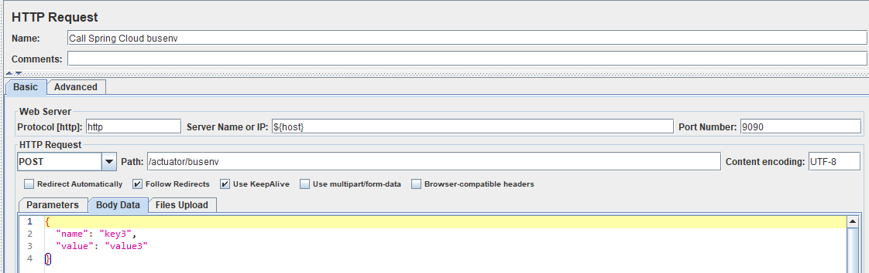
Spring Cloud Bus (cont.)
We can use the POST /actuator/busenv request to trigger env property changes.
The microservice will receive the environment variable changes instantly.

Slide 79
Ribbon
Spring Cloud Ribbon is a powerful client-side load balancing library that empowers service clients to balance requests intelligently across multiple instances of a target service, improving scalability and fault tolerance in microservice environments.
Ribbon uses pluggable algorithms, integrates with service registries, and supports health checks to optimize request routing.
This was the default client load balancer in Spring Cloud Netflix projects, although newer Spring Cloud versions recommend Spring Cloud LoadBalancer as a successor to Ribbo.

Slide 80
Ribbon (cont.)
Key Points
Client-Side Load Balancer: Unlike server-side load balancing where a central load balancer routes traffic, Ribbon runs on the client (service caller) side, deciding which service instance it will send requests to.
Service Discovery Integration: Ribbon can integrate with service registries like Netflix Eureka, fetching the list of available service instances dynamically.
Load Balancing Strategies: Ribbon supports various load balancing algorithms out-of-the-box, such as:
Round-robin
Random
Weighted response time
Zone-aware (prefers instances in the same zone)
Health Checks (Ping): Ribbon can ping service instances to check if they are alive and only route traffic to healthy instances.
Customizable: Developers can define custom load balancing rules, servers lists, and health checking strategies.
Used with Feign: Ribbon is often used alongside Netflix Feign as the client-side load balancer for declarative HTTP clients in Spring Cloud.

Slide 81
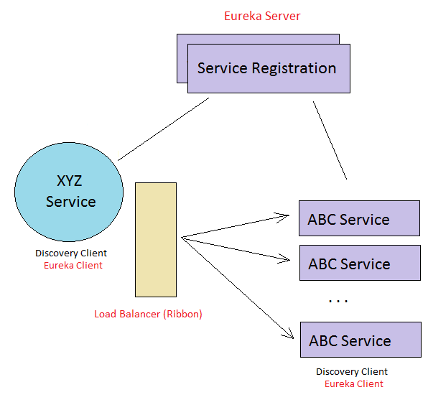
Ribbon (cont.)
Ribbon Load Balancer Architecture

Slide 82
Ribbon (cont.)
Netflix Ribbon has been officially deprecated and was removed from Spring Cloud starting with the 2020.0.x (codename: Ilford) release train.
Since then, Spring Cloud recommends using Spring Cloud LoadBalancer, which is the modern replacement maintained by the Spring team.
Spring Cloud LoadBalancer offers similar client-side load balancing features and better integration with the Spring ecosystem.

Slide 83
Zuul
Zuul is the Netflix-originated API Gateway solution incorporated into Spring Cloud.
Zuul facilitates routing, filtering, and proxying of requests to backend microservices, enhancing manageability, security, and scalability of microservice ecosystems.
Since Zuul 1.x is blocking, Spring Cloud now recommends the Spring Cloud Gateway based on reactive programming (Project Reactor) for modern applications.
Gatway | Status in 2025 | Notes
Netflix Zuul 1.x | Deprecated, not recommended | Blocking, servlet-based, legacy
Netflix Zuul 2.x | Not supported in Spring Cloud officially | Reactive but no official Spring Cloud module
Spring Cloud Gateway | Modern and recommended | Reactive, Kubernetes-friendly, active development

Slide 84
Zuul (cont.)
Key Points
API Gateway: Zuul serves as the single entry point that proxies and routes external client requests to multiple internal microservices in a manageable way.
Routing: It dynamically routes incoming HTTP requests to various backend services based on configurable rules.
Filters: Zuul’s core consists of a flexible filter mechanism that allows pre-processing, routing, post-processing, and error handling for requests.
Pre-filters: Execute before the request is routed (e.g., authentication, logging).
Route-filters: Handle forwarding the request to the destination service.
Post-filters: Run after the request has been routed (e.g., modifying response headers).
Error-filters: Handle errors and exceptions during processing.
Integration with Netflix OSS: Can integrate with Netflix Eureka for service discovery, Ribbon for client-side load balancing, and Hystrix for fault tolerance.
Blocking IO: Zuul 1.x is based on Servlet 2/3 and uses a blocking I/O model, hence it may have limitations in handling very high concurrency.
Spring Cloud Zuul Starter: Spring provides auto-configuration and integration to easily set up and use Zuul in Spring Boot microservices.

Slide 85
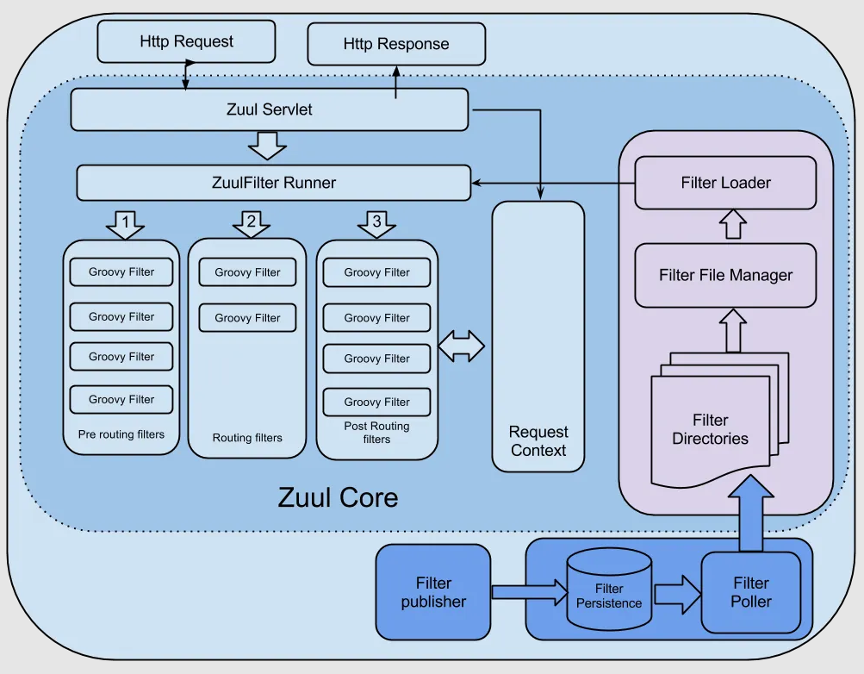
Zuul (cont.)
Zuul API Gateway architecture

Slide 86
Hystrix
Hystrix is a circuit breaker library integrated with Spring Cloud that monitors calls to remote services and automatically stops calls to failing services to prevent cascading failures.
Hystrix isolates faults with fallback mechanisms and resource isolation, improving overall resilience and stability in microservice architectures.

Slide 87
Hystrix (cont.)
Key Points
Command: Encapsulates a service call or action that may fail or timeout. Each service call is wrapped in a command.
Circuit Breaker: Monitors the health of commands (success/failure rate). If failure exceeds a threshold in a rolling window, it opens the circuit.
Fallback: Method to be invoked when the primary command fails, times out, or the circuit is open, providing a graceful degradation.
Timeout: Maximum time to wait for a command to complete before considering it failed.
Thread/Resource Isolation: Commands run in separate threads or thread pools allowing failures to be isolated from other parts of the system.
Metrics: Hystrix collects runtime data like success, failure rates, latencies for monitoring.

Slide 88
Hystrix (cont.)
Benefits:
Prevents failures in one microservice from cascading and bringing down the overall system.
Improves system stability and user experience by providing fallback responses or degraded functionality.
Provides detailed metrics and monitoring dashboards for real-time fault detection.
Is easily enabled via Spring Boot starters and annotations like @HystrixCommand.

Slide 89
Hystrix (cont.)
Hystrix is not available as an actively maintained component in Spring Cloud 2025.
The Hystrix project has been in maintenance mode since late 2018 with no active development or new features.
Since Spring Cloud 3.1, Hystrix Dashboard was removed, marking the official end of Hystrix in Spring Cloud.
The recommended replacement for Hystrix in the Spring ecosystem is Resilience4j, which supports modern circuit breaker, rate limiter, retry, and bulkhead patterns natively.

Slide 90
Conclusion
Pros:
Seamless integration with other Spring frameworks
Provides solutions for common microservices patterns like load balancing, circuit breakers, and distributed messaging (integration with RabbitMQ, Kafka).
Streamlines cloud application deployment and configuration management.
Supported by a large community, extensive documentation, and ecosystem.
Cons:
High learning curve, especially for beginners or those new to microservices.
Can require significant configuration and setup time, increasing complexity.
Documentation sometimes outdated or challenging to follow.
Limited support for legacy systems.
Potential performance bottlenecks in very large-scale systems due to overhead.
Configuration and integration complexity can grow as projects become larger.

Slide 91

Bibliography
https://spring.io/projects/spring-cloud
Udemy - Learn Spring Cloud components and use them for your micro services in easy steps
https://medium.com/@vikas.taank_40391/refreshing-spring-config-with-cloud-bus-ded2a802ef4c

